Slide 1


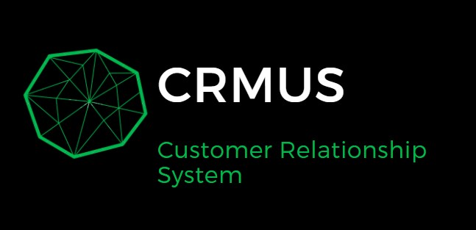


Darmenov Bekzhan & Chagirov Sanzhar
Group: CS-2009
Teacher: Adilbek Dostiyarov
Astana IT University, 2021

Slide 2


Outline
Introduction
Responsibilities of each member
Main body of the project (ERD, code, analytics)
Learning outcomes
Conclusion

Slide 3

Introduction
Our Project “CRMUS”- is small console CRM system in Java with data analysis by Python. The program is designed to interact with data from the database such as customers, orders, products, etc. Data analysis was carried out using the python libraries pandas, numpy, matplotlib on Jupyter notebook.

Slide 4
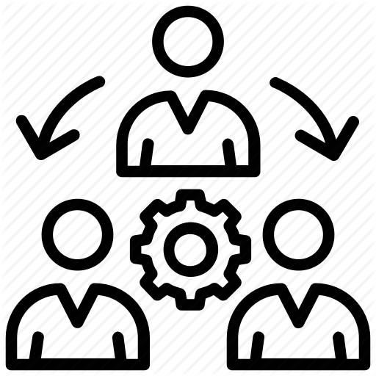
Responsibilities of each member
Firstly, we discussed all the points of our project, what and how we will do, main idea and for what purpose, we discussed the further promotion of the project and our responsibilities.
In short,
Bekzhan was responsible for the ERD Diagram, work with Database, import data to DB, data analytics, report presentation.
Sanzhar was responsible for write code in Java, interaction with the database and the user, write main and other functions.

Slide 5
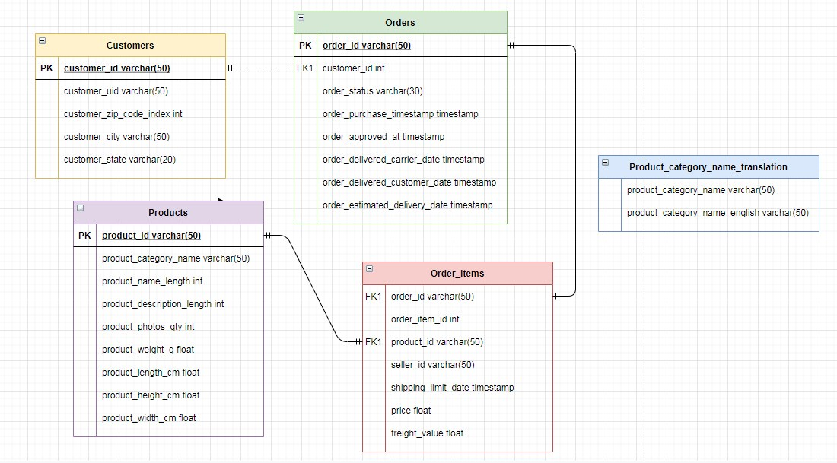
ERD diagram

Slide 6
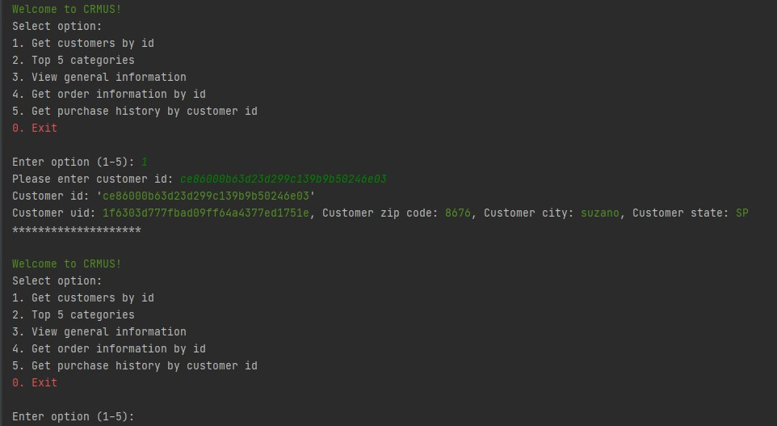
Code

Slide 7
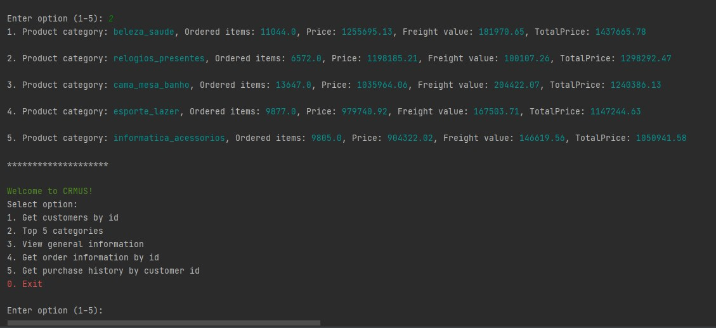
Code

Slide 8
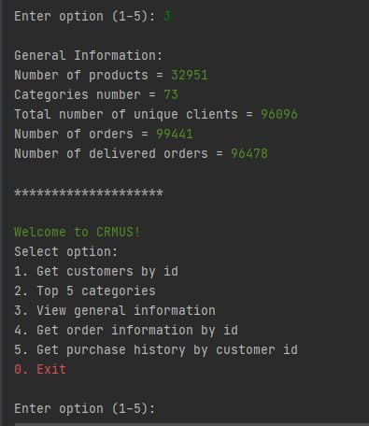
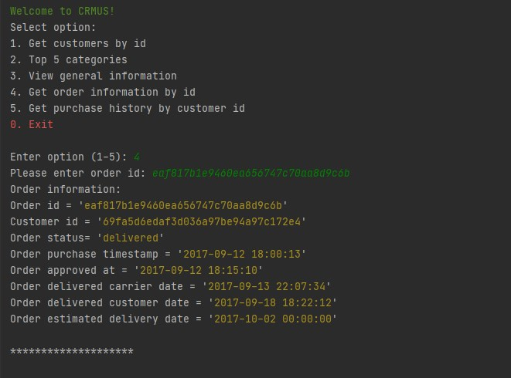
Code

Slide 9
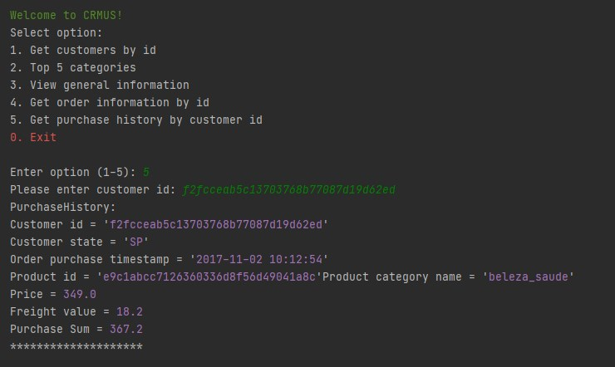
Code

Slide 10
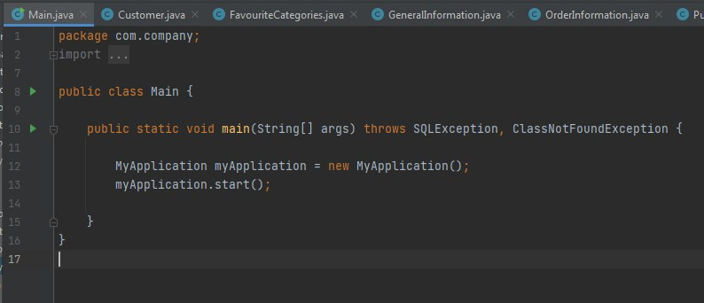
Code

Slide 11
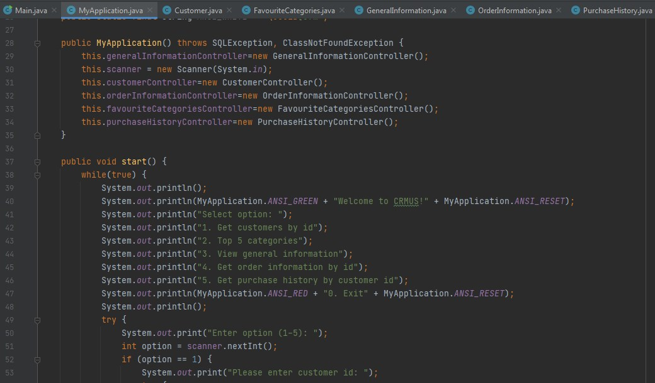
Code

Slide 12
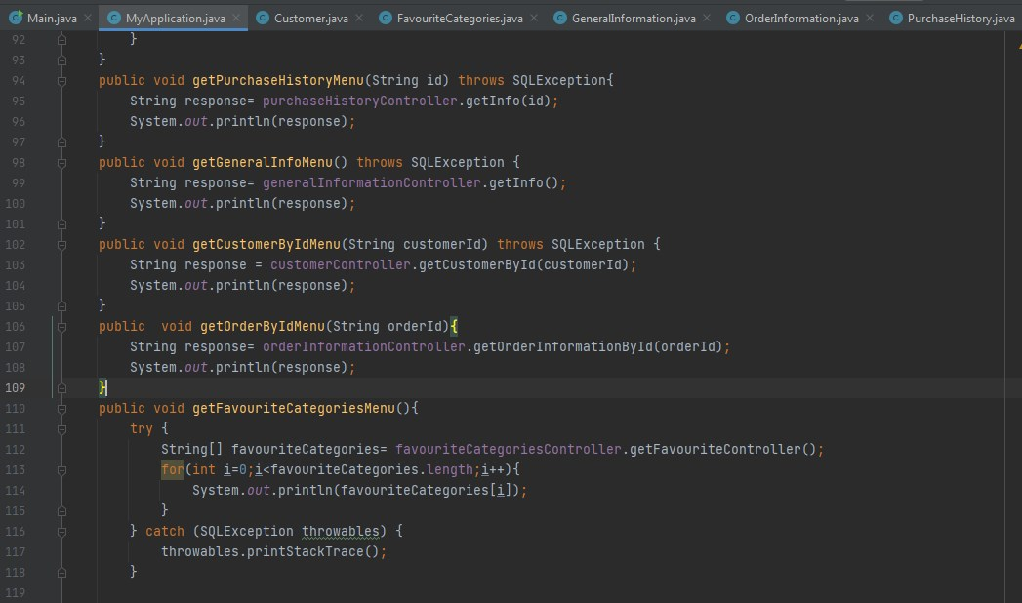
Code

Slide 13
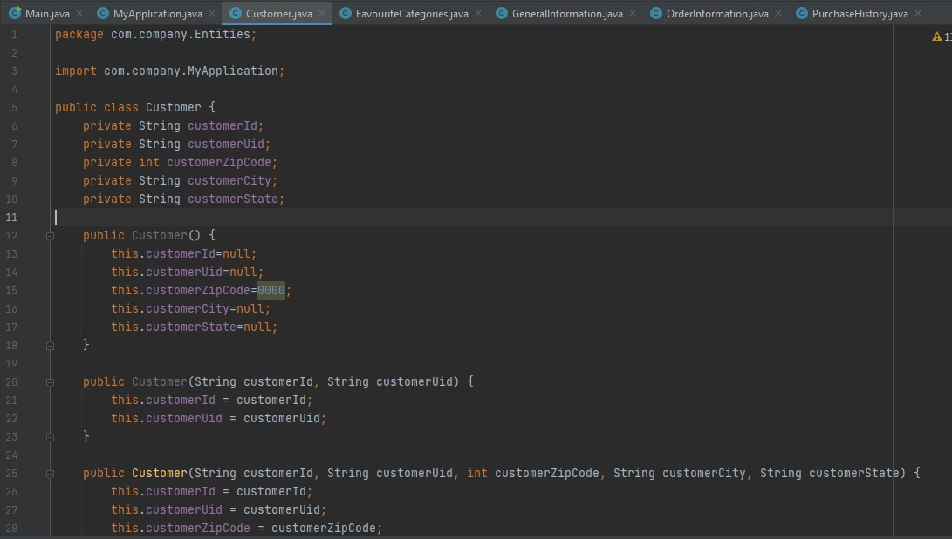
Code

Slide 14
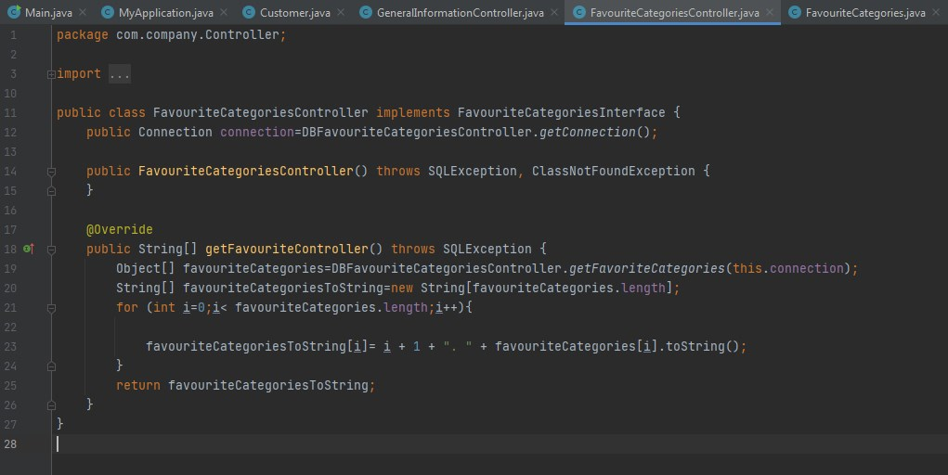
Code

Slide 15
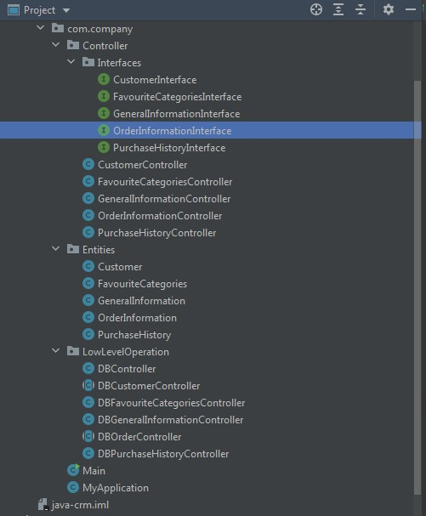
Code

Slide 16
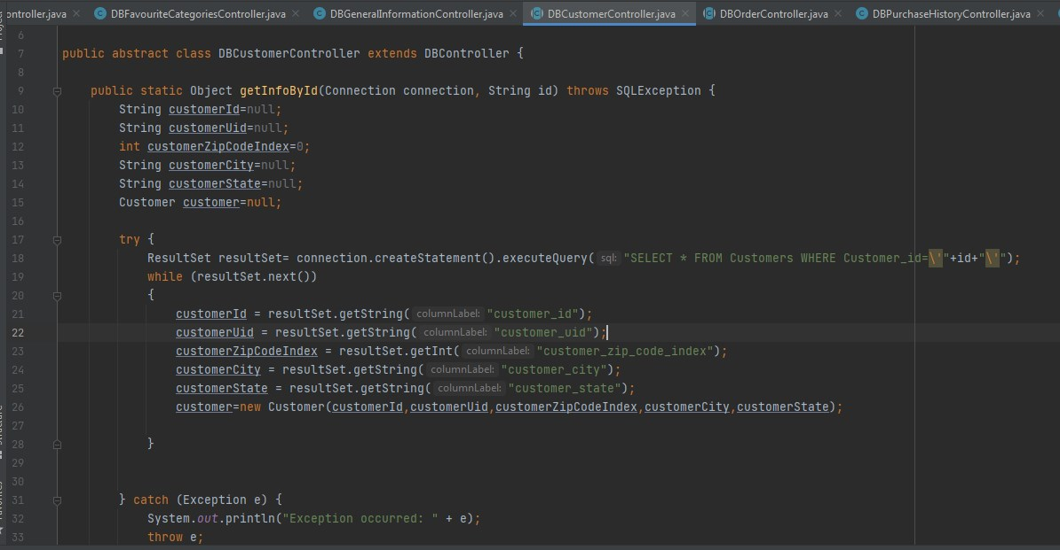
Code

Slide 17
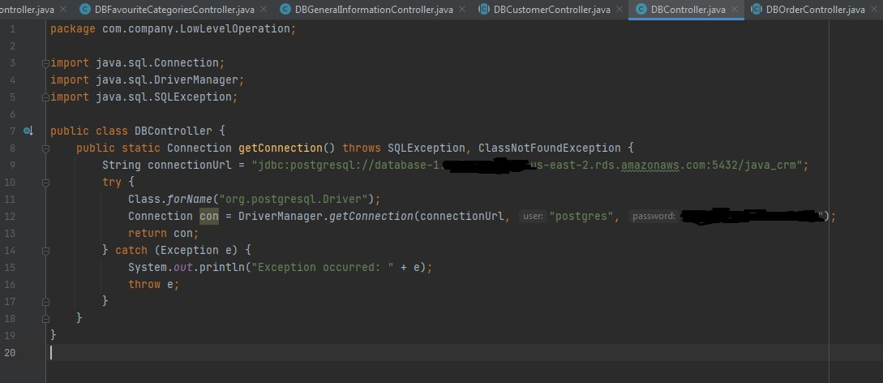
Code

Slide 18
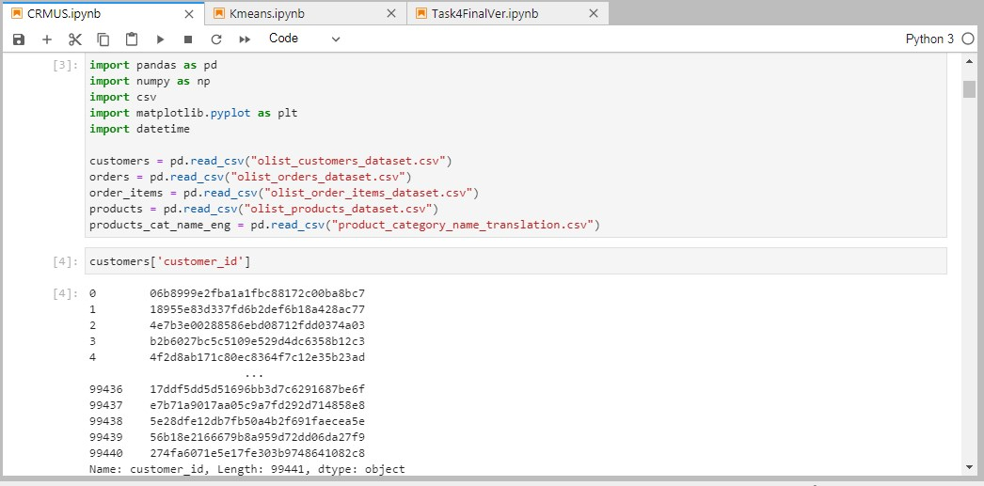
Analysis

Slide 19
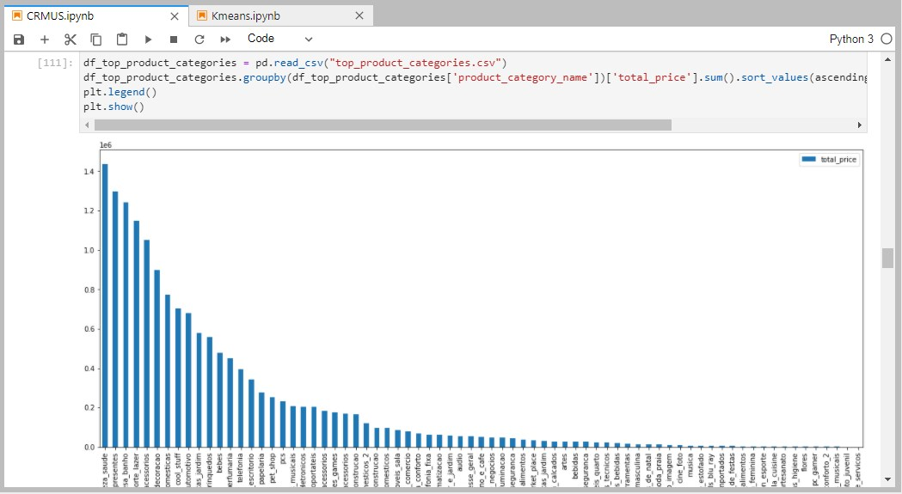
Analysis

Slide 20
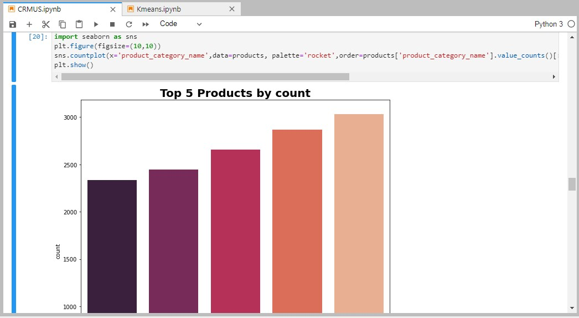
Analysis

Slide 21
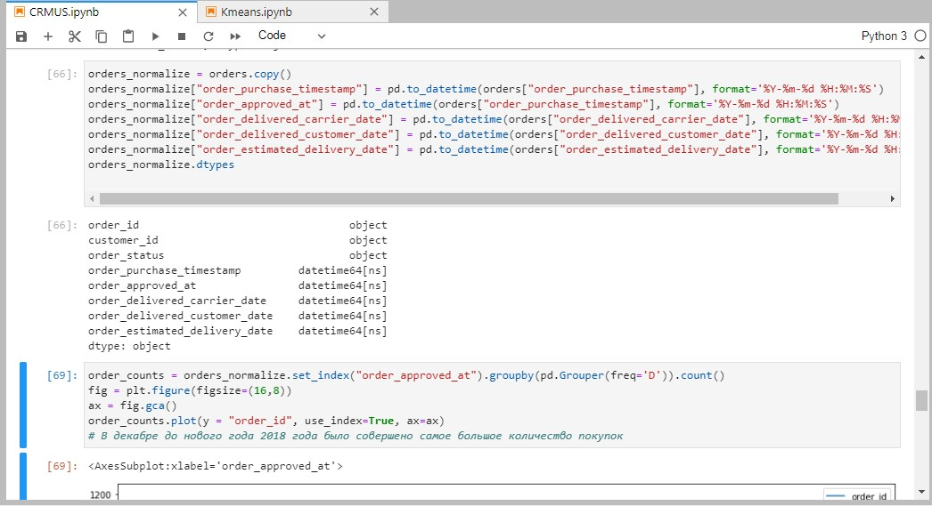
Analysis

Slide 22
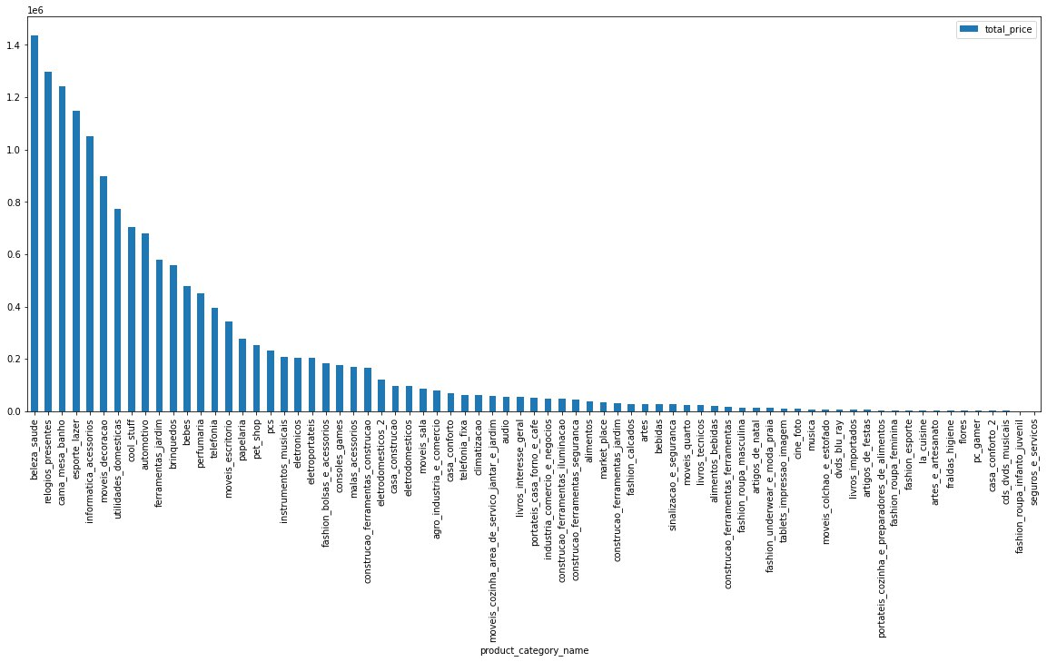
Top products sorted by total value sold

Slide 23
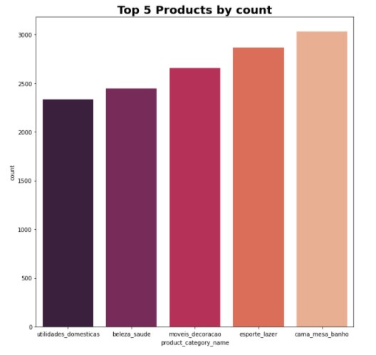
Top 5 products sorted by count

Slide 24
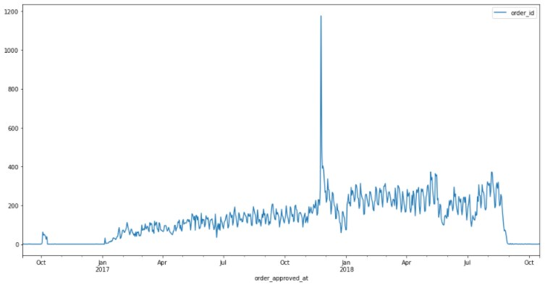
Orders infographic

Slide 25
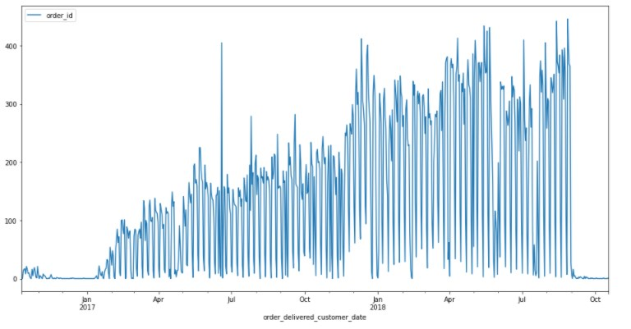
Delivered orders infographic

Slide 26

Learning outcomes
While doing this project, we learned to feel free when using OOP principles in example of Java also to write and instantly fix errors in Java code.
And we also got experience in data analysis using Python, its libraries on Jupyter Notebook.

Slide 27


Conclusion
The main users can be anyone any one, because its easy to learn use this simple system.
----------------------------------------------------------------------------------
The weak points are so far that have no Graphical Interface (GUI), less functionality and because of there not enough time, we didn’t have time to develop this project properly.
----------------------------------------------------------------------------------
But among potential future updates maybe we can improve and develop this project.
----------------------------------------------------------------------------------
In conclusion, I will say that the project has many opportunities in the future, and if develop it properly with more functions it is also convenient for instantly using like real CRM system for users needs.

